Slide 1








1. Characters in Romeo and Juliet
Romeo Montague | Son and heir to the nobel Montague family. | Impulsive, rash, non-violent at first but does kill Tybalt. Shows characteristics of a courtly lover.
Juliet Capulet | Daughter of the nobel Capulet family. Marries Romeo. | Independent, passionate, headstrong and decisive. Closer to her nurse than her mother.
Lord Capulet | Patriarchal head of the nobel Capulet family. | Seems caring at first but his pride and power lead to aggression and violence towards Juliet.
Lady Capulet | Wife via arranged marriage to Lord Capulet. Juliet’s mother at 12 years old. | Submissive to her husband, not close to her daughter, does not challenge the society she lives in
Tybalt | Juliet’s cousin. Lord and Lady Capulet’s nephew. | Loyal to his family. Aggressive and violent. A skillful fighter. Kills Mercutio whilst fighting Romeo.
Mercutio | Romeo’s friend. ‘Kinsmen’ of Prince Escalus. | A funny and witty character. A loyal friend to Romeo. ‘Mercurial’ meaning volatile or quick to react.
Friar Lawrence | A holy man in Verona, a monk. A fatherly figure to Romeo. | Wise, trustworthy and well intentioned. Believes that the marriage between R and J may heal the grudge.
The Prince | The voice of authority in Verona. He tries to administer justice to the feuding families. | Tries to keep peach on the streets. Banishes Romeo. Brings catharsis to the audience in Act 5 Scene 3 when the grudge ends.
2. Literary techniques or Methods used by Shakespeare
Foreshadowing | When the writer gives hints and clues as to what will happen later in the text. E.g. Shakespeare uses the motif of tombs and graves throughout the play to foreshadow Romeo and Juliet’s deaths. “My grave is like to be my wedding bed”.
Dramatic Irony | When the audience know things that the characters in the play do not know. E.g. The audience know that Juliet is not dead but Romeo does not. Act 5 Scene 3“crimson in thy lips and in thy cheeks”.
Soliloquy | When the character in a play speaks their thoughts aloud so the audience can understand their thoughts and feelings. E.g. Juliet’s soliloquy when she stands at her window and does not know Romeo is there in Act 2 Scene 2. “What’s in a name?”.
Oxymoron | A figure of speech in which two ideas directly contradict or oppose each other. Shakespeare uses Oxymorons throughout the play to show contrasting themes. E.g. Romeo in Act 1 Scene 1 “O loving hate!”.
Imagery | Using visual language (oftens metaphors) to depict something for the audience. For example Shakespeare uses imagery to show to Romeo’s admiration for Juliet. Juliet is “a rich jewell” and “the sun”.
Comic Relief/ Bawdy Humour | Shakespeare includes humour in the play to offset the tragic ending - often this humour is bawdy meaning it contains sexual innuendo or indecent references (particularly when men are talking about women)
QR Codes
Plot Summary for every scene
Tragic Structure of R and J
4. Context of Romeo and Juliet and Conventions of Tragedy
Tragedy | A play in which the audience know the tragic outcome at the start. They watch the downfall of the tragic hero which ultimately leads to their death.
Fatal Flaw/ Hamartia | In a tragedy, the tragic hero(es) have a character trait that leads to their downfall. Romeo is impulsive and Juliet is impatient. They both are single minded and individualistic.
Prologue | An introduction at the beginning of a literary work - used in tragedies to reveal the ending of the play.
The Wheel of Fortune | Elizabethans believed that the Goddess Fortuna spun the Wheel of Fortune and an individual's luck could change because of this.
The Globe Theatre | Shakespeare’s plays were watched by a cross section of social classes. Lower class audience members stood in the pit and were known as groundlings, the bawdy humour was often aimed at these audience members
Patriarchal Society | Despite the fact there was a female monarch on the throne, Elizabethan society was one in which men has power over women. Women could not vote or take professional jobs and were primarily expected to be wives and mothers (“Vessels”). Upper class women in particular were seen as property of their male relations.
Astrology | Many Elizabethans believed that God decided your fate, and that astrology could help you identify your course in life. The belief that your life is mapped out and ‘written in the stars.’
5. Talk like an Expert
Antithesis | The direct opposite of something else. E.g. Benvolio is the antithesis of Tybalt.
Conventional | The way things are usually done or normal beliefs.
Effeminate | Less stereotypical ‘manly’ more sensitive.
Feminist | Someone who believes men and women are equal. Opposes patriarchy.
Futile | Pointless or hopeless.
Bigamy | Marrying someone who is already married.
Mortal sins | The Catholic belief that some sins would prevent you from going to heaven.
Protagonist | The leading or main characters (the tragic heroes)
Submissive | Obedient to authority
Catharsis | Emotional release for the audience.
3. Themes and Big Ideas In Romeo and Juliet
Love |  | Unrequited love between Romeo and Rosaline. Forbidden love between Romeo and Juliet- they treat love almost like a religion. Family love between Juliet and the nurse rather than her own mother Love through friendship E.g. Romeo and Mercutio Marriages for love were very rare and were frowned upon by Elizabethan society
Fate |  | Elizabethan beliefs about fate and astrology are evident in the play. From the prologue R and J are described as “Star crossed lovers”. It seems as if the protagonists cannot escape fate and therefore their love is futile.
Conflict and Violence |  | The play opens with violence and there is another street fight in Act 3 Scene 1. Violence is used a way for upper class Elizabethan men to show their masculinity. There are other types of conflict also evident in the play such as the internal conflict as characters have conflicted thoughts and conflict within families (“Hang thee young baggage”)
Family |  | The feud (“Ancient Grudge”) between the families is at the centre of the play’s plot. Honour, reputation and loyalty are very important to these families. Whilst Montagues and Capulets fight for status in Verona there is also conflict within families. Juliet’s independence see her in conflict with her parents. Juliet is closer to the nurse (who would have been her wet-nurse as a child) than she is her own mother.
Society and Individuals |  | Shakespeare explores the freedom of the individual vs. the restrictions imposed by society. The Prince’s character helps demonstrate the danger of breaking social rules and trying to exercise free will. Suicide and bigamy would both have been considered mortal sins in Catholic Verona.
Gender |  | In the play, Verona is a society dominated by male aggression and violence. Romeo in portrayed as a more effeminate male within the play. Lady Capulet’s young, arranged marriage to Lord Capulet reflects conventional gender roles and in contrast to her mother, Juliet shows characteristics of a feminist.

Slide 2
Timeline of Publication |  | Key Context for each poem | Structure/ Key Features | Big Ideas/Themes
London (1594) |  | Reflects the Romantic suspicion of large institutions of Power. Inspired by the French Revolution and anti-establishment ideologies. Reflects issues of crime and poverty in the metropolitan heart of the British Empire. | ABAB alternate rhyme scheme replicates Blake’s footsteps walking through London. | Power of state over individuals; political conflict reinforcing inequalities; power in revolution.
Ozymandias (1818) |  | Based on the real statue of Ramesses II, Egyptian pharaoh. An ironic satire of dictatorial power. The statue was being moved to the British Museum in London- the British Empire claiming a symbol of power. | The sonnet form is ironic. It reflects Ozymandias’ love of power and hubris. Shelley is mocking tyrannical leaders. | Even the mightiest will fall; you cannot beat time; pride comes before a fall; power of art and words.
The Prelude (Writing from 1798, published 1850) |  | Classic Romantic poetry rejecting modernity and praising the power or nature. Poet out walking and feels overwhelmed- The Sublime. | An extract of a larger poem. The continuous enjambment and blank verse reflect the idea of ‘journey’. | Understanding our place in the world; limitations of human power; memory.
My Last Duchess (1842) |  | Based on (the real) Duke of Ferrara Alfonso whose wife mysteriously disappeared in suspicious circumstances. Seventeen year old Lucrezia was from ‘new money’ House of Medici , whereas the Duke was the heir to a 900 year old dynasty. | Dramatic monologue. The Duke is speaking to an emissary who has come to discuss the Duke’s next marriage but only the Duke speaks. Shows the Duke’s authority and hubris. | Absolute power; power of language and material objects; control over others; legacy; generational wealth and status; patriarchy and masculinity.
Charge of the Light Brigade (1854) |  | Written in response to the Battle of Balaclava in the Crimean War. Glorifies sacrifice to manage the public mood following the unnecessary loss of life following a miscommunication in the chain of command in this battle. . | Lots of anaphora to represent the relentless repetition of the cannonfire in the ‘valley of death’. | Reality of war; celebrates bravery of soldiers and honours the sacrifices they made; propaganda.
Exposure (1918) |  | WWI anti-propaganda, exposing the truth to the home front. As a soldier, Owen suffered from shellshock and was treated in hospital before being sent back to the front. | Repetition at the end of each stanza. Reflects the boredom and repetition of trench warfare. | Reality of war and resulting death; dismisses the glamorisation of patriotism
Bayonet Charge (1957) |  | Written about WWI trench warfare. Hughes’ father had fought in WWI. Hughes saw the impact of a ‘lost generation’ of men after WWII. | The first stanza uses enjambment to speed up the poem. In the second stanza caesura slows the poem down. | Fear and terror felt by soldiers; questions patriotism and highlights war’s damage to both humans and nature
Storm on the Island (1966) |  | Written 2 years before The Troubles began in Northern Ireland in 1968- the storm was brewing. The political building Stormont is hinted at in the title. | Extended metaphor. The storm pummeling the Island is a metaphor for the Troubles in Northern Ireland. | Powerlessness of humans; human desire to control vs. nature’s destructive force.
War Photographer (1985) |  | About Don McCullin, Duffy’s friend and famous war photographer, who documented the Vietnam War, and The Troubles, etc. | The poet uses caesura to force the reader to stop and pause out of respect for those who have lost their lives. | Horrors of war; internal conflict; memory l morality; home front Vs front line.
Emigree (1993) |  | Written in the 1993 to reflect rising immigration into the UK- perhaps inspired by news coverage of the mass migration due to the Bosnian War. The speaker is female. | Each stanza ends with a reference to sunlight- perhaps a reflection of the enduring image of ‘home’. | Conflict between memory and reality; othering and exclusion; human limitations.
Checking out Me History (2005) |  | Based on Agard’s experiences growing up in British Guyana before it was liberated from the British Empire in 1966. | Parts in italics are intended to be sung. This promotes the idea that the poem is a celebration of identity not a rant. | Limited versions of history; individual identity; positive role models; power of language; how colonisation and this impact on identity.
Tissue (2006) |  | Written after 9/11 for an anthology entitled ‘The Terrorist at my Table’, Dharker reflects on the fragility of life and the power of politics, religion and money over humanity. | Extended metaphor, paper represents life. | Fragility of human life; power of paper to change things and record memories; physical symbols of power.
Remains (2008) The Gulf War |  | Based on the true experiences of Robert, a soldier in Iraq. He spoke about his PTSD experience for a Channel 4 documentary called ‘The Not Dead’. | Last stanza is a couplet. Armitage says this could be to represent the dead and the not dead, or to represent the two ‘bloody hands’. | Horrors of war and PTSD; recurring memories of conflict and killing
Poppies (2009) |  | Do not confuse the speaker with the poet (Weir did not have a son who went to war). Written for an anthology called ‘Exit Wounds’ when there was significant media focus on flag draped coffins. | The stanzas show the passing of time. Enjambment reflects the mother’s voice and the conversation tone of the poem as she reflects on memories. | Mother’s feelings toward her son growing up; grief; parental impulse to protect a child; home front.
Kamikaze (2009)) |  | About young intelligent Japanese WWII Kamikaze pilots who sacrificed themselves in suicide missions for Samurai honour. They were recruited with propaganda straight from Japanese Universities. | Italics indicate the change in speaker,like the daughter is passing the story on. The whole poem is just three sentences. His journey out; his journey back; his life after. | Conforming to social expectations; internal conflict; familial conflict; propaganda.

Slide 3
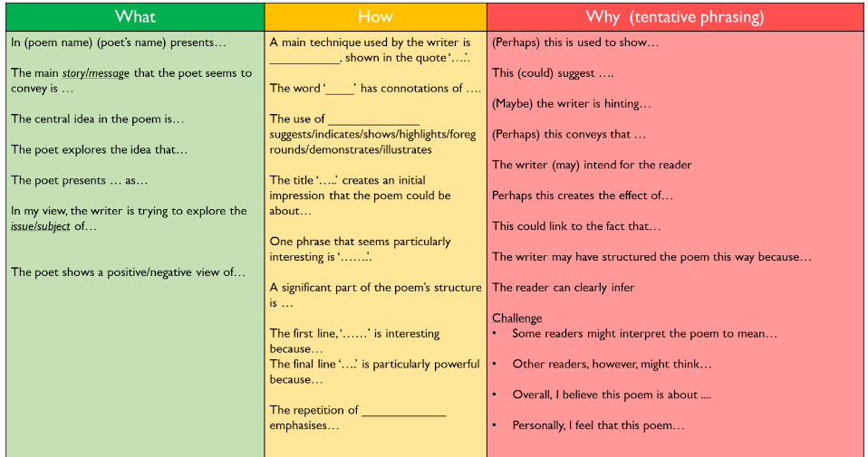
Language Techniques
Metaphor | A comparison of dissimilar objects or ideas (made directly or indirectly) without using ‘like’ or ‘as’.
Plosive | ‘b’, ‘p’, ‘t’, and ‘d’ sounds which can be harsh, aggressive, or shocking.
Assonance | a repetition of vowel sounds.
Sibilance | Repeated ‘s’ sounds (most often caused by ‘s’, ‘ss’ and ‘c’. These can be harsh, smooth, or sickly.
Semantic Field | A set of words relating to the same topic to create or reinforce a theme. ‘Foul’ and ‘shot’ would appear in the semantic field of sports.
Colloquial Language | Local/casual language, often appears conversational in tone.
Euphemism | Making something unpleasant, taboo, or embarrassing seem more appropriate. Saying someone has ‘passed away’ is a euphemism for death.
Imagery | Visually descriptive or figurative language, such as similes or metaphors.
Pathetic Fallacy | Assigning human feelings and responses to inanimate thing
Hyperbole/ Litotes | An extreme exaggeration / A deliberate understatement
Allusion | a reference to a well-known thing, person, or saying that the poet believes the reader will recognise.
2. Structure Techniques
Rhyme | The repetition of syllable sounds, usually at the ends of lines, but sometimes in the middle of a line (called internal rhyme).
Rhythm | The beat or cadence of a poem.
Couplet | A pair of rhyming lines which follow on from one another.
Stanza | A group of lines separated from others in a poem.
Enjambment | The continuation of a sentence without a pause (usually from punctuation) at the end of a line, couplet, or stanza.
Anaphora | A repetition of words, phrases, or clauses, usually at the beginning of lines.
Juxtaposition | Two things placed close together for contrasting effect.
Caesura | A stop or pause in a line of poetry, usually caused by punctuation.
Volta | A turning point in the line of thought or argument in a poem.
Syntax | Word order and sentence structure.
Repetition | Using the same word/phrase more than once
QR Code
Step by Step- approaching an unseen poem
5. Talk like an Expert
Poet | The person who wrote the poem
Persona/ Speaker | The voice or perspective used in the poem.
Tone | The feelings, attitude and opinions in the poem
3. Poetic Structures and Forms
Free Verse | Non-rhyming poetry which follows the rhythms of natural speech.
Blank Verse | Poetry written in non-rhyming, ten syllable lines.
Dramatic Monologue | A poem in which an imagined speaker addresses the reader.
Sonnet | A fourteen line poem, with variable rhyme scheme, usually on the topic of love for a person, object, or situation.
Ballad | A narrative poem, often written in 4-line stanzas.
Haiku | A poem written in 3 lines, containing the following pattern of syllables: 5, 7, 5; often about nature.
Elegy | A sad and thoughtful poem about the death of a person or thing.
Pastoral | A poem about nature or simple country life.

